Slide 1
HTML 5

Slide 2
HTML5 Audio and Video
The audio and video elements add new media options to HTML5 applications that allow you to use audio and video without plugins while providing a common, integrated, and scriptable API.

Slide 3
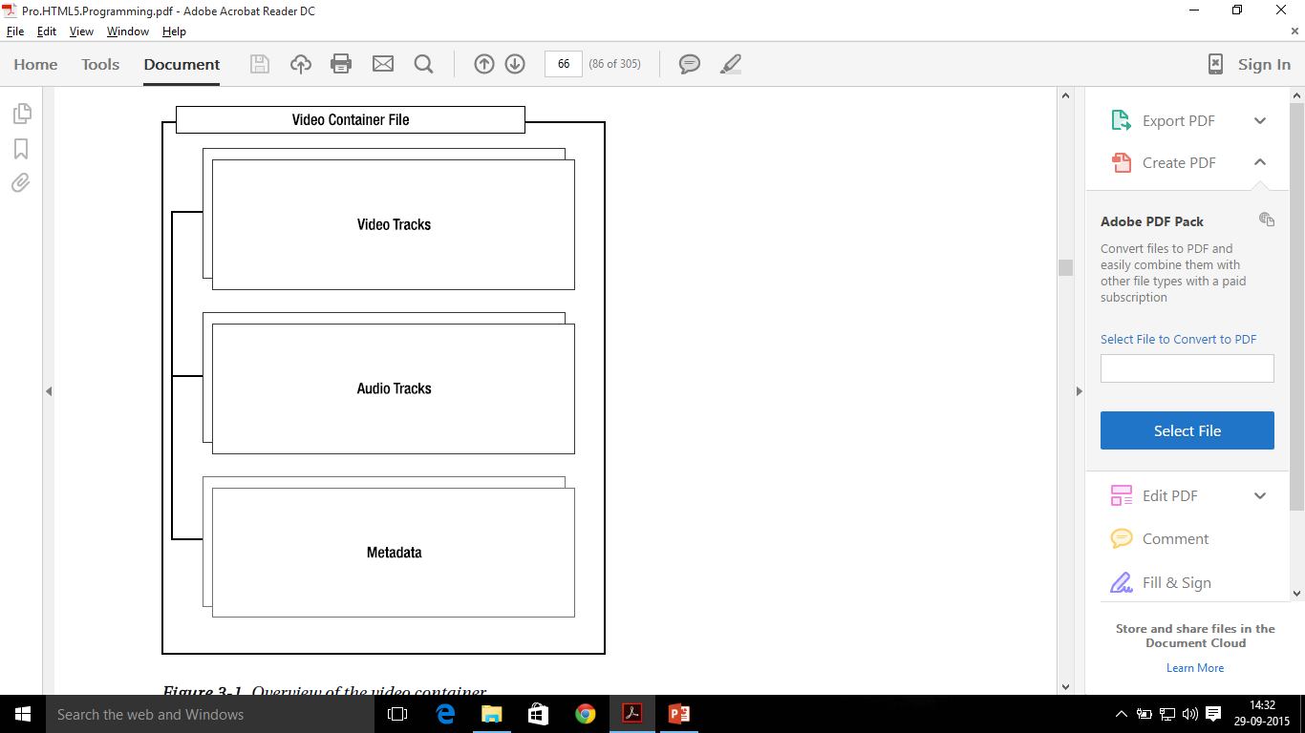
Video Containers
An audio or video file is really just a container file, similar to a ZIP archive file that contains a number of files. A video file (a video container) contains audio tracks, video tracks, and additional metadata. The audio and video tracks are combined at runtime to play the video. The metadata contains information about the video such as cover art, title and subtitle, captioning information, and so on.

Slide 4
HTML5 New Semantic / Structural Elements – Page 2
Tag | Description
<menuitem> | Defines a command/menu item that the user can invoke from a popup menu
<meter> | Defines a scalar measurement within a known range
<nav> | Defines navigation links in the document
<progress> | Defines the progress of a task
<section> | Defines a section in the document
<summary> | Defines a visible heading for a <details> element.
<time> | Defines a date/time
<wbr> | Defines a possible line-break

Slide 5
HTML5 New Form Elements
Tag | Description
<datalist> | Defines a pre-defined options for input controls
<keygen> | Defines a key-pair generator field (for forms)
<output> | Defines the result of a calculation

Slide 6
HTML5 New Input Types
New Input Types | New Input Attributes
Color | Autocomplete
Date | Autofocus
Datetime | List
Email | Height and Width
Month | Min and Max
Number | Pattern
Range | Placeholder
Search | Required
Tel | Step
Time
Url
Week

Slide 7
HTML5 New Graphics Elements
Tag | Description
<canvas> | Defines graphic drawing using JavaScript
<svg> | Defines graphic drawring using SVG

Slide 8
HTML5 New Media Elements
Tag | Description
<audio> | Defines sound or music content
<embed> | Defines containers for external applications
<source> | Defines sources for <video> and <audio>
<track> | Defines tracks for <video> and <audio>
<video> | Defines video or movie content

